Slide 1
‘When will I need Trigonometry?’

Slide 2
We need to address the Anti-Maths Mind Set

Slide 3
PISA Programme for International Study Assessment
‘’ PISA, measures the mathematical literacy of a 15-year-old to formulate, employ and interpret mathematics in a variety of contexts to describe, predict and explain phenomena, recognising the role that mathematics plays in the world. The mean score is the measure. A mathematically literate student recognises the role that mathematics plays in the world in order to make well-founded judgments and decisions needed by constructive, engaged and reflective citizens.’’

Slide 5
Maths, You and Real Life Life is like a box of chocolates

Slide 6
Ages 11-16
Tuck Shop
Shopping
School Trips
Baking and cooking
Catching the bus- reading the timetable
Enterprise - budding entrepreneurs - The Enterprise Project Year 9

Slide 7
Ages 16-18
Driving Lessons
Car Insurance
Car Repair
The Car itself!!

Slide 8
Age 18+ year
Destination University Student Loan - Academic
Driving Lessons
Rent - Student Accommodation
Destination - Apprenticeship
Food
Utility Bills

Slide 9
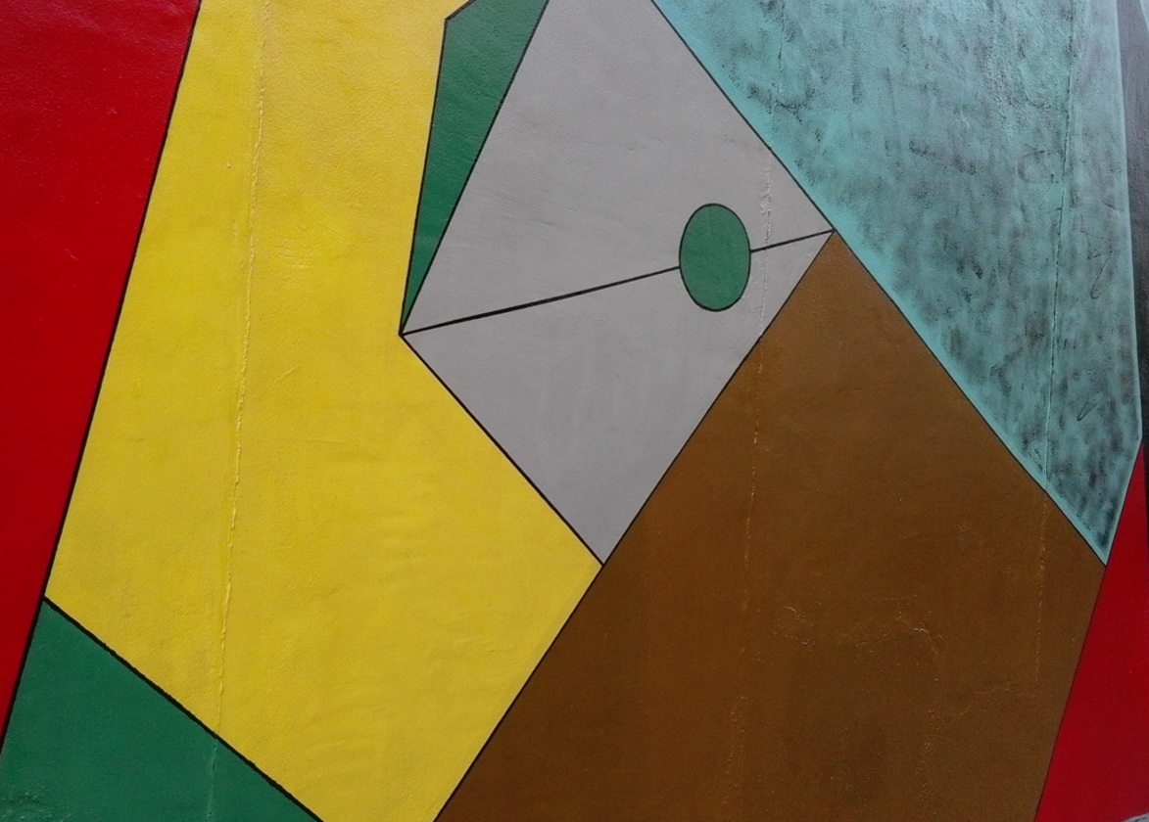
Where is the maths in that?
Different angles
Different shapes
Different areas
How many colours do we need? Shapes next to each other cant be the same colour

Slide 10
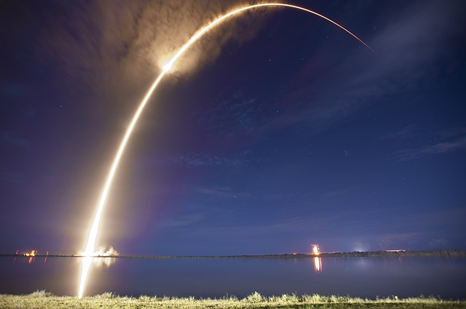
Where is the maths in that?
The speed of the rocket
The angle at which it is launched
Gravity, calculating forces
The trajectory can be modelled by a quadratic curve

Slide 11
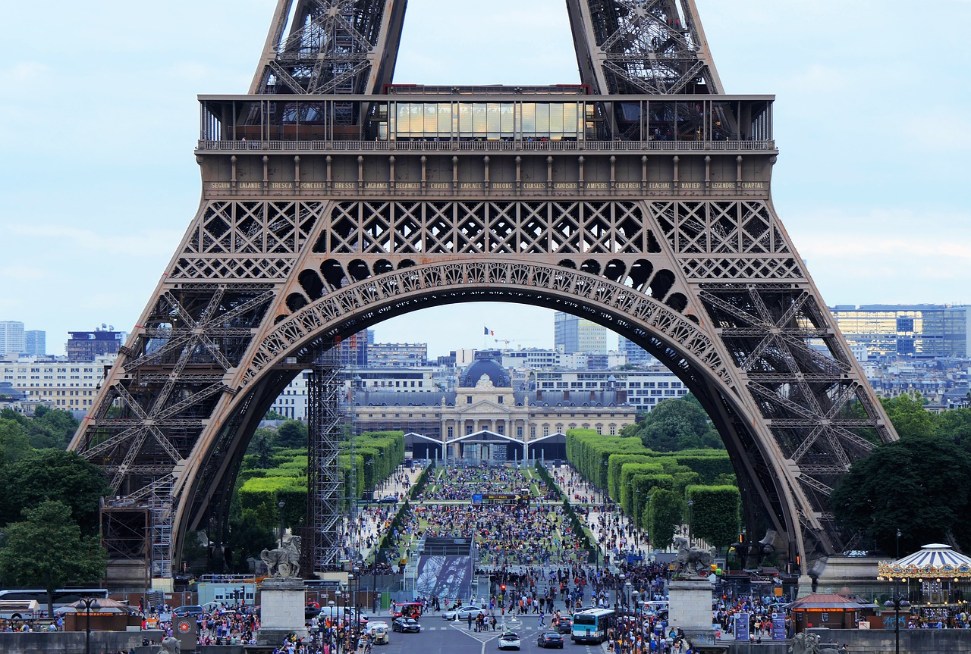
Where is the maths in that?
Different shapes, how do they all fit together
Precise measurements
How many people visit per day? What is the revenue
Density of people per m2, how many people are allowed in

Slide 12
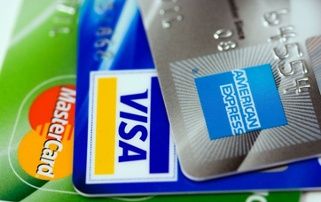
Where is the maths in that?
What is credit
Interest rates (percentages)
Pin numbers, how many combinations are there
Budgeting

Slide 13
Key points
Maths is all around is
Maths is creative
Maths is not always about being right or wrong

Slide 14
How to develop your mindset
Work hard
Behave well
Stay focused
Be persistent
Seek to improve Recall
Ask for help when you need it
Keep practicing

Slide 15
The Good News & There is plenty of it
Congratulations to All the participants JMC 2023 and to the Intermediate Maths Challenge participants

Slide 16
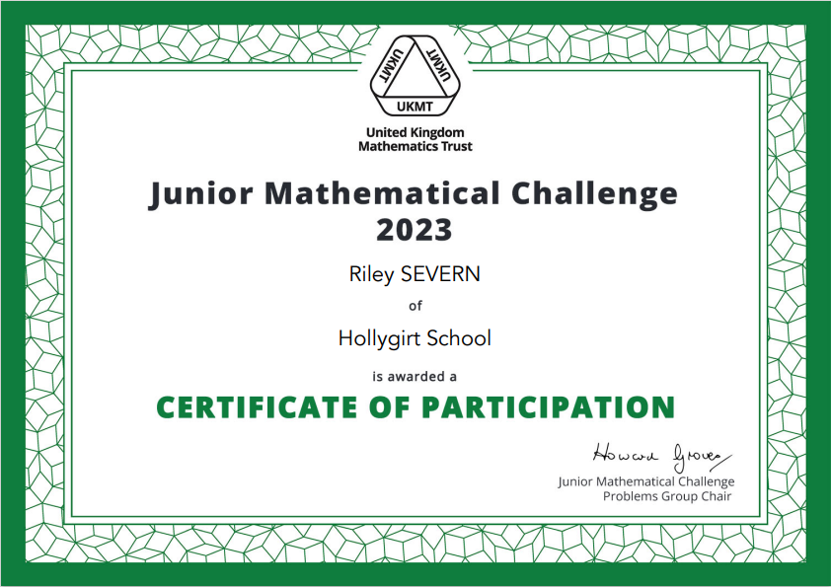

Slide 17
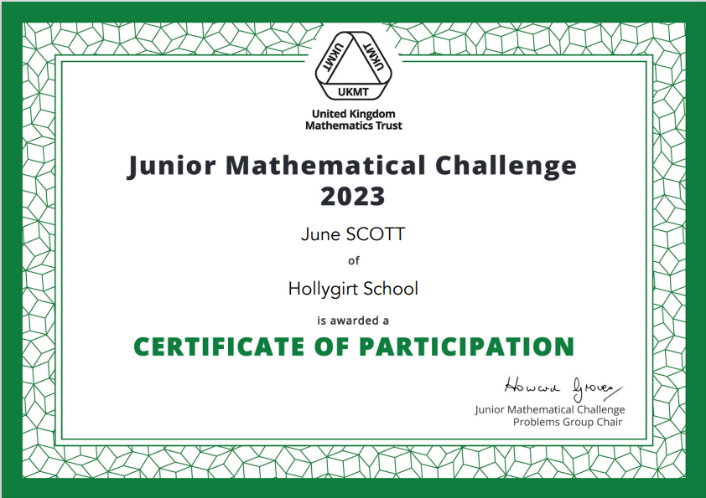

Slide 18
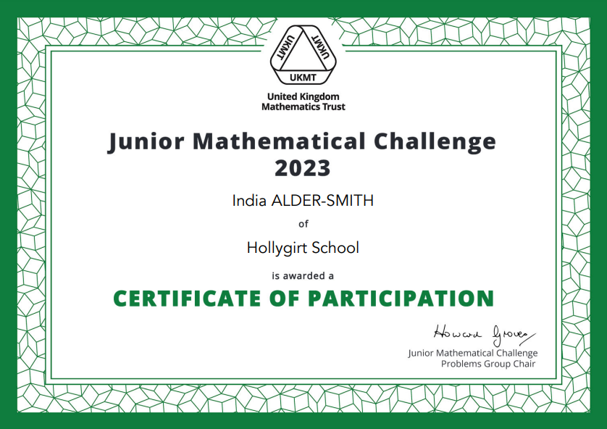

Slide 19
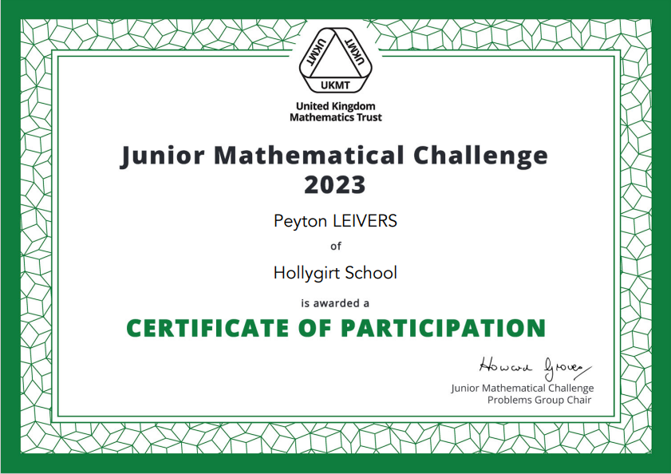

Slide 20
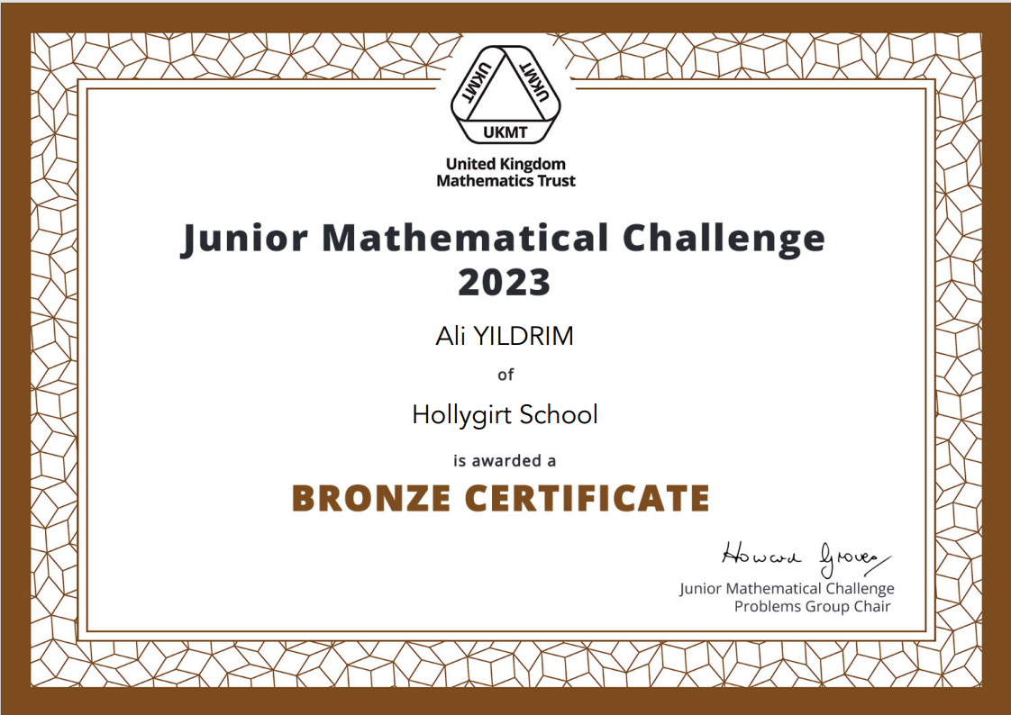

Slide 21
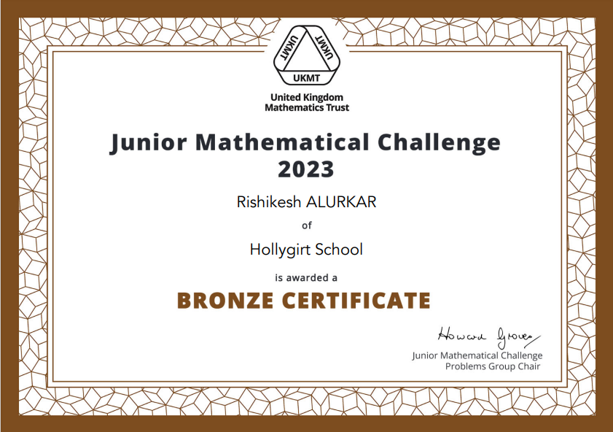

Slide 22
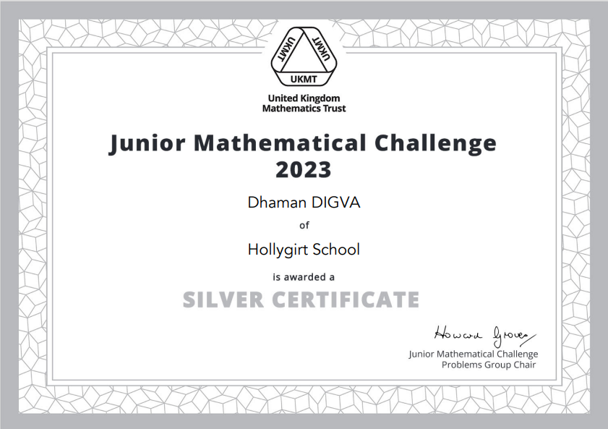

Slide 23
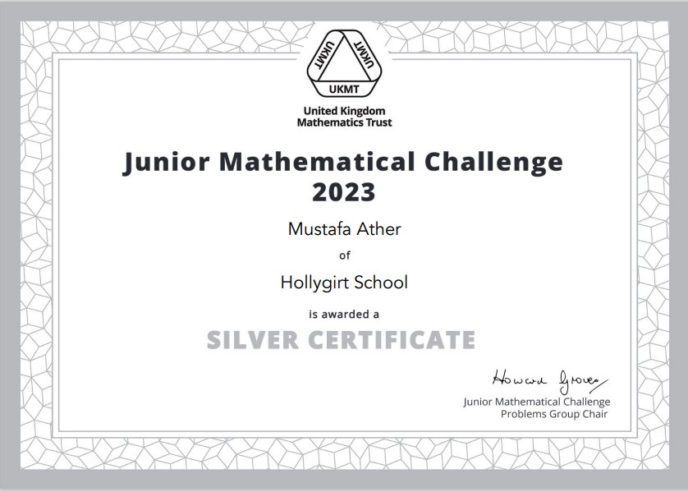

Slide 24
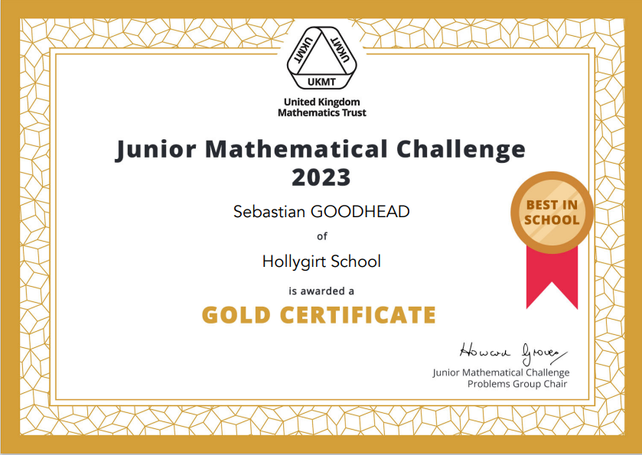

Slide 25
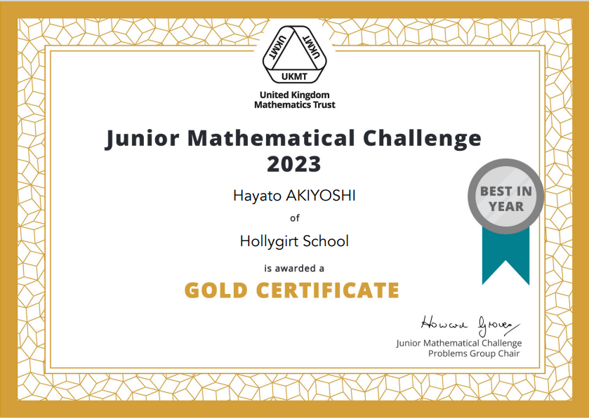

Slide 26
… and well done to all those that took part in the algebra masterclass, came to maths clinic or just tried really hard in maths!

