Slide 2
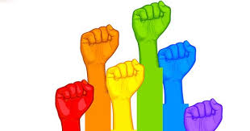
LGBT BASICS
LGBT people have existed throughout history, but because they often kept their sexuality secret, we might be unaware of the contribution that they have made to our society.
LGBT History Month celebrates the achievements of LGBT people with the aim of promoting equality and diversity for the benefit of everyone.
Notes:
First, the basics: Who are we talking about? What does LGBT mean? LGBT stands for “Lesbian, Gay, Bisexual and Transgender”.
Most people are heterosexual, or “straight”. They are attracted to the opposite sex and when they grow up they will probably do the usual thing – set up home with someone of the opposite gender and have babies.
However, for a large number of people, sexuality is not that straightforward. Gender and sexuality are usually linked, but not always. So some men are attracted to other men. Some women are attracted to other women. Some people are attracted to both men and women. Some feel that they have been born with the wrong gender altogether – they might have the body of a man, but their feelings and their brain are those of a woman. Some people aren’t that fussed about sex at all.

Slide 3
CHALLENGE
That guy is bent.
You act like a fag, you’re such a homo.
School is gay.
She is retarded, a total mentalist.
My sister is a lesbian.
My nan has mental health issues.
My godfather is gay.
Derogatory/offensive inappropriate
Inappropriate/Misuse of word: Makes no real sense
Acceptable, factual description
EXTRA: What about the words…
Bent? Queer? Homo?
Notes:
In this school- none of the RED or BLUE words are acceptable.

Slide 4
ANSWERS
That guy is bent.
You act like a fag, you’re such a homo.
School is gay.
She is retarded, a total mentalist.
My sister is a lesbian.
My nan has mental health issues.
My godfather is gay.
Derogatory/offensive inappropriate
Inappropriate/Misuse of word: Makes no real sense
Acceptable, factual description
Notes:
In this school- none of the RED or BLUE words are acceptable.

Slide 5
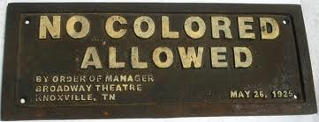
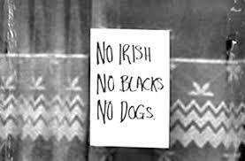
Language- Past & Present
Language often changes to reflect attitudes & values of the times we live in.

Slide 6
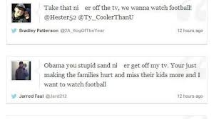
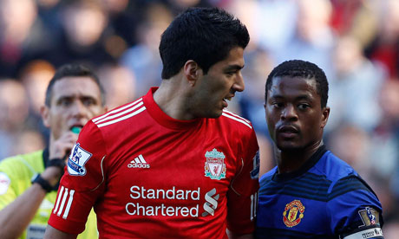
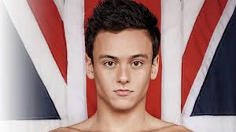
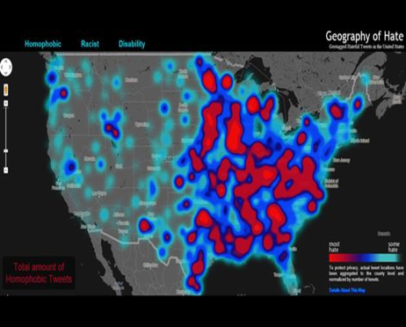
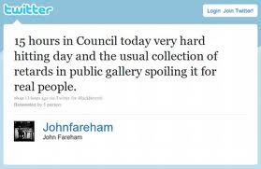
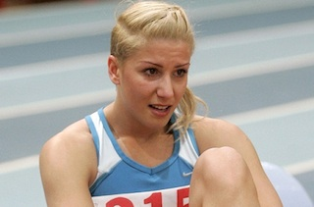
#OutofOrder
Does it matter? My language, my business.
Not so. You could be fined, fired or arrested for your use of language( verbal or online) if it is deemed racist or homophobic or offensive ( physical or mental disability).
Can you think of any stories that have made the news?
Notes:
One of the most powerful and destructive ways that prejudice and discrimination can take hold of a culture is to allow hateful or demeaning words sneak in to its everyday language. Although words can seem meaningless, they plant seeds of fear and hatred which may lead to violence and division.
We want to show you a clip which contains words that are divisive and hateful. It clearly shows the effect that name-calling, hurtful and derogatory language can have on the individual and society..

Slide 7
No Bystanders; Stonewall
Notes:
Stonewall #NoBystanders - commercial – YouTube
You’ll notice that the hateful words and attitudes in this clip begins at school- this is because research suggests that at school we learn behaviours that we will take with us into the wider world./ We wanted to show you that the way we behave, the words we choose to use here at our school will effect the way we feel and act towards others- today and in the future.

Slide 8
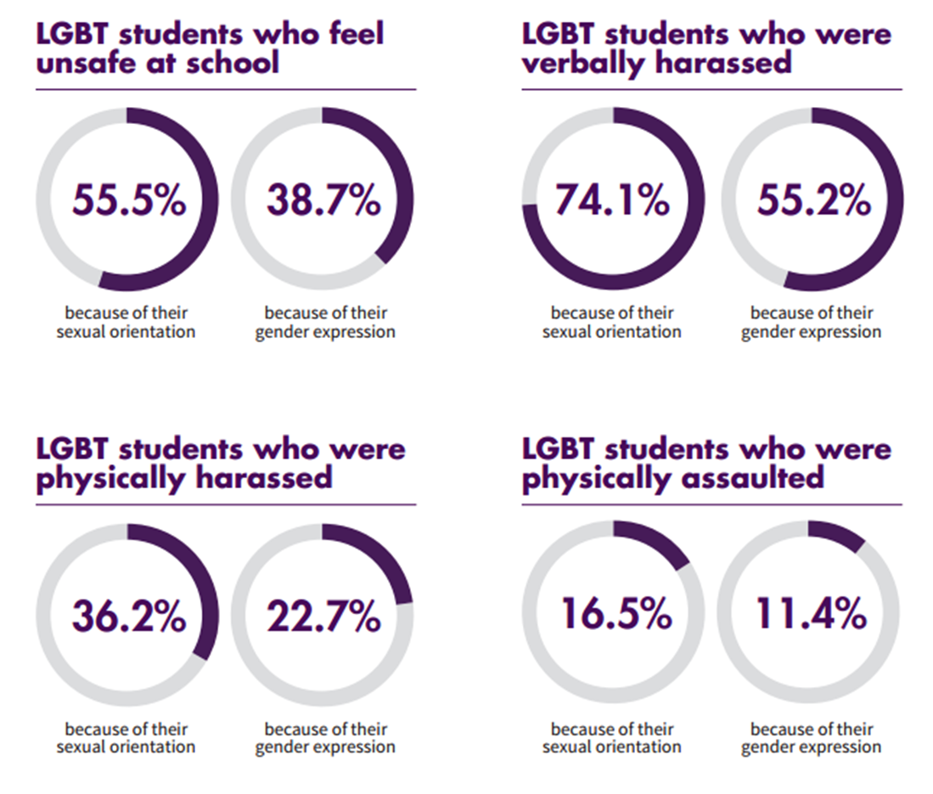

Slide 9
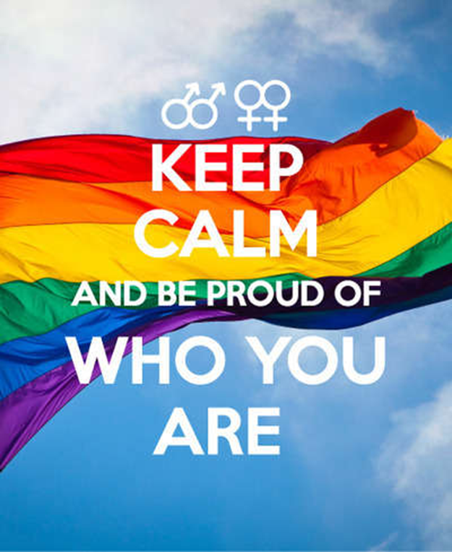
Notes:
Unfortunately, gay people have not always been able to be honest about their sexuality for fear of discrimination or even punishment, so the idea that all gay people look or behave in a certain way is obviously not true.

Slide 10
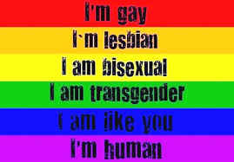
Notes:
Scientists are still trying to figure out what it all means: what makes one person gay and another person straight? No one has a definitive answer, but all the scientific research is making one thing increasingly clear: sexuality is not a choice. People do not choose to be gay or straight or transgender. Sexuality appears to be decided by a number of factors, many of which go right back to how a baby develops in the womb. It’s to do with hormone levels, the growth of neural pathways in the brain and may even be caused by a certain combination of genes in a person’s cells.
But there are people who deny the evidence. They say, “Hang on, if it’s natural to be gay, then how come there are more gay people about than there used to be?”
Well there aren’t. Scientists reckon that the proportion of homosexual people is between 6 and 10 per cent. So in a class of 30 pupils, 2 people are likely to be gay. As far as the scientists and historians can tell, the proportion of homosexual people in a society has always been the same, but until very recently it has rarely been easy for homosexual people to live their lives freely, so they were much less likely to come out.

Slide 11
Notes:
We are fortunate to live in a country where homosexuals have the same rights as heterosexuals – but this equality only came about after long years of campaigning which only ended last March when gay marriage laws finally came into force. Same-sex couples are now able to get married instead of having a civil partnership, which gives them the same rights and responsibilities as heterosexual couples. However, in other parts of the world, LGBT people still suffer terrible discrimination. Homosexuality is illegal in many countries across Africa, the Middle East and South Asia. Gay people can be fined, imprisoned, beaten in public or even executed. In many countries where homosexuality is allowed, there are no laws to prevent discrimination against LGBT people, so they often suffer terrible prejudice.

Slide 12
Notes:
Even in the UK, attitudes to LGBT people have only recently changed. When our grandparents, and even some of our parents were young, homosexuality was illegal in parts of the UK. It was decriminalised in England and Wales in 1967, but remained illegal in Scotland until 1980, and in Northern Ireland until 1982. in 2010 the Equality Act was passed which makes it illegal for people to discriminate against homosexuals when providing goods and services – so for example, a hotel cannot refuse a room to a couple just because they are gay.

Slide 13
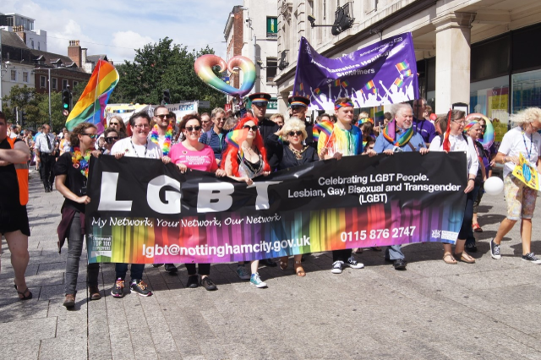
Love has no Labels
Notes:
https://vimeo.com/121388342
It’s been a long journey but we are finally living in a society where being LGBT doesn’t – or at least shouldn’t – matter, and this change has been reflected in the media. It wasn’t long ago that many gay celebrities were afraid to come out because they thought it would damage their careers. But celebrities such as Ellen De Generes, Alan Carr, Caitlyn Jenner, Graham Norton and Clare Balding feel confident to present their true selves mainly because they are famous at a time when identifying as LGBT isn’t such a big deal for the audience. These days we have openly gay actors, presenters, politicians and sports personalities; and nobody - well, almost nobody - thinks anything of it.

Slide 14
OUR PLEDGE
We agree everyone has the right to feel safe.
We understand that all people, regardless of sexual orientation and gender identity, should be treated with dignity and respect.
We work on eliminating homophobia from our own words and actions
We do not tolerate anti-LGBT language and behaviour.
We support each other and know we can seek appropriate help throughout our school community.
Notes:
And that’s how we want it to be here at Hollygirt .. And everywhere. We want to show our support and acknowledge that Lesbian,gay.bisexual and transgender people have always made a hugely valuable contribution to our families, friendships, cultures and communities because they have always been a hugely valuable part of our families, friendships,cultures and communities.

Slide 15
THANK YOU!

