Slide 1
Student Volunteer Day
Monday 20th Feb

Slide 2
(5) What is volunteering? - YouTube
Notes:
This is V inspired introductory video – This slide is optional: https://www.youtube.com/watch?v=x-7kf3CkDwQ

Slide 3
Volunteering is simple.
It’s about choosing to give time to help people, the community or society, the environment or animals.

Slide 4
Improving student wellbeing
These are usually very interactive and fun, helping you to socialise. It also encourages students in other places to set up their own activities and celebrations during this week.
Notes:
NCVO website – sources. 21 million and £22.6 billion are the correct answers

Slide 5
Developing student’ employability
Student Volunteering Week aims to do this by providing students with more opportunities to volunteer. They can increase awareness of the ways in which students are able to volunteer. Volunteering makes students more appealing to any future jobs that they apply to.

Slide 6
Contributing to the wider and local environment
You may become more excited and passionate about volunteering for your chosen topic.

Slide 7
There are over 160,000 voluntary organisations .
Over 850,000 people work in the voluntary sector (either full or part time, 65% are women).
The charity sector gets its money from many of different places including individuals and the government.

Slide 8
What does the future look like for charities?
Spending on public services (buses, schools, hospitals, care) and squeeze on households.
More people will need the services of a charity.
With changes in relations with Europe and less money being spent on people on low incomes, charities need to fight for fairness and equality.

Slide 9
Even though many volunteers need to be 14 to join or raise money for a charity…
How you might do it. Join a nationally recognised organisation or maybe something more local?
Try looking into areas that might interest you – raising money for a skate park, research into diseases, or helping those less fortunate.

Slide 10
Volunteering teaches you useful new skills things like communication skills, team work and decision making.
Notes:
https://vinspired.com/whats-the-point-of-volunteering and https://vinspired.com/whats-the-point-of-volunteering

Slide 11
Duke of Edinburgh Award
(5) Bronze | start your DofE - YouTube

Slide 12
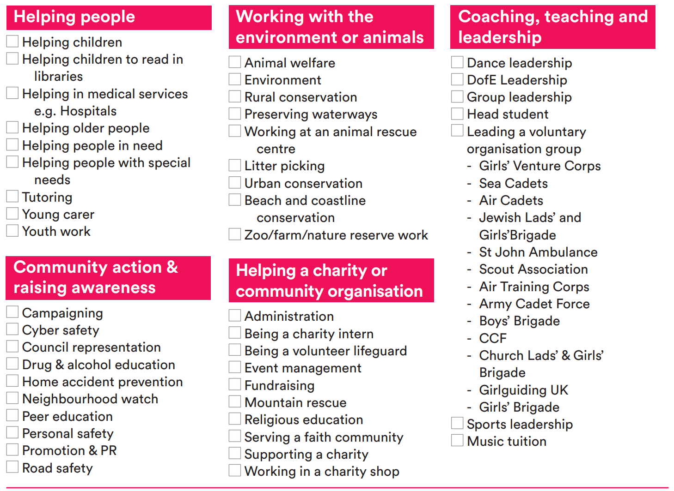

Slide 13
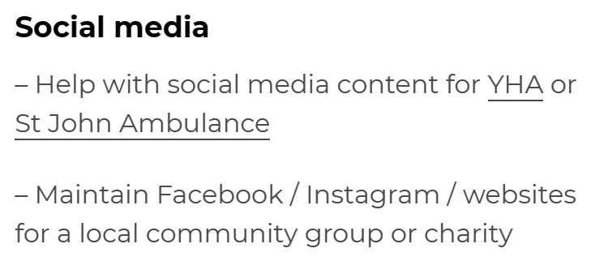
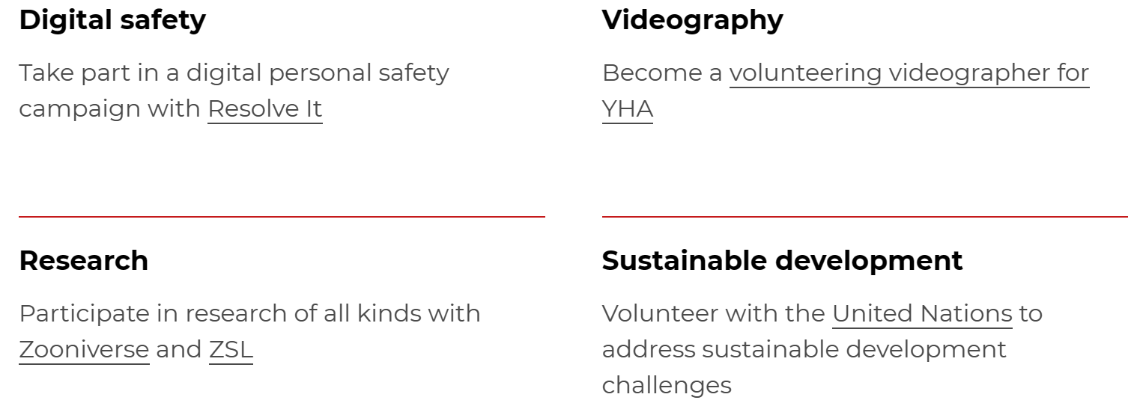
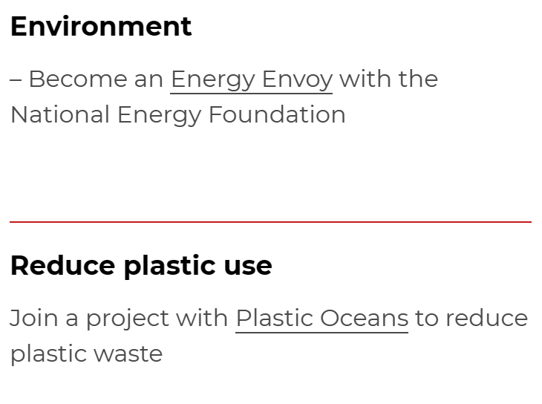
Some Ideas!

Slide 14
You may choose to organise their own charity work through school or by setting up a cake sale or other charity event.

