Slide 1
World Mental Health Day 2022

Slide 2
World Mental Health Day
This Years theme is:
'Make mental health and wellbeing for all a global priority'
World Mental Health Day is also a chance to talk about mental health in general, how we need to look after it, and how important it is to talk about things and get help if you are struggling.

Slide 3
https://www.youtube.com/watch?v=DxIDKZHW3-E

Slide 4
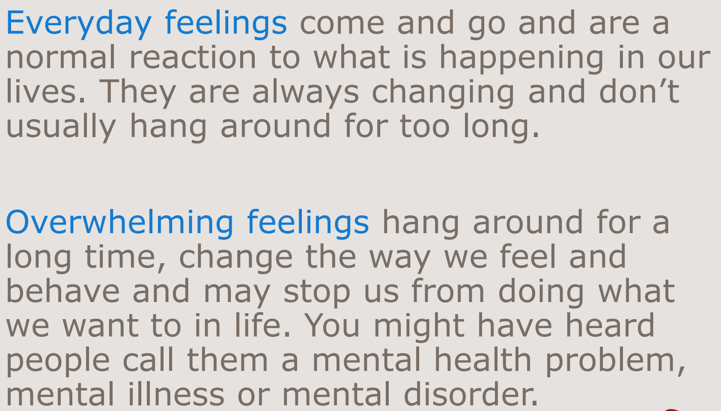
Feelings

Slide 5
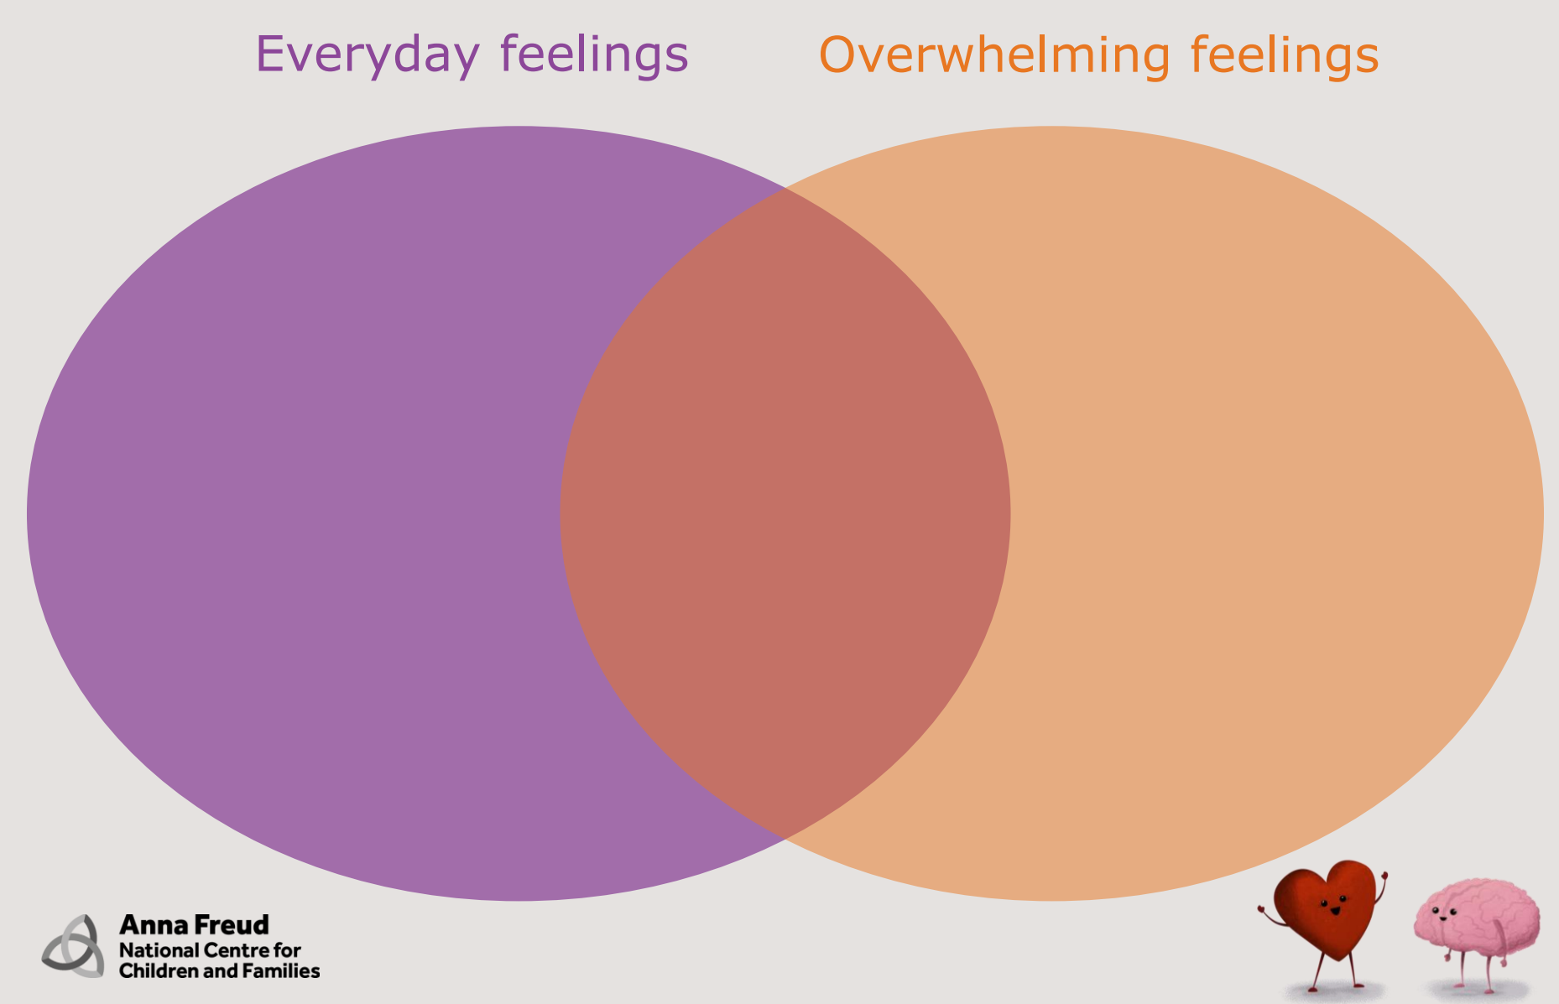
Feelings

Slide 6
How can we look after our own mental health?

Slide 7
How can we look after our own mental health?
Keep Moving
Our bodies and minds are connected, so looking after ourselves physically also helps us prevent problems with our mental health (it works the other way around, too).
Moving our bodies – with sport, gardening, dancing, cycling, walking the dog, cleaning or going to the gym, for example – are great ways to improve our mental and physical health.
Exercise releases “feel good” hormones that reduce feelings of stress and anger. It also helps us feel better about our bodies. It can improve our sleep too. If it involves other people, like being part of a team, a class or a group we see regularly, that can also boost our mental health.

Slide 8
How can we look after our own mental health?
Eat Healthy foods
Food and drink affect our bodies, brains and mood - for good or bad.
Sugary snacks and drinks can give us a temporary “high” or sense of comfort that can feel irresistible. But they soon leave us feeling exhausted or jittery.
Caffeine in coffee, tea, or so-called energy drinks can also have this effect.
A balanced diet with lots of vegetables and fruit is essential for good physical and mental health

Slide 9
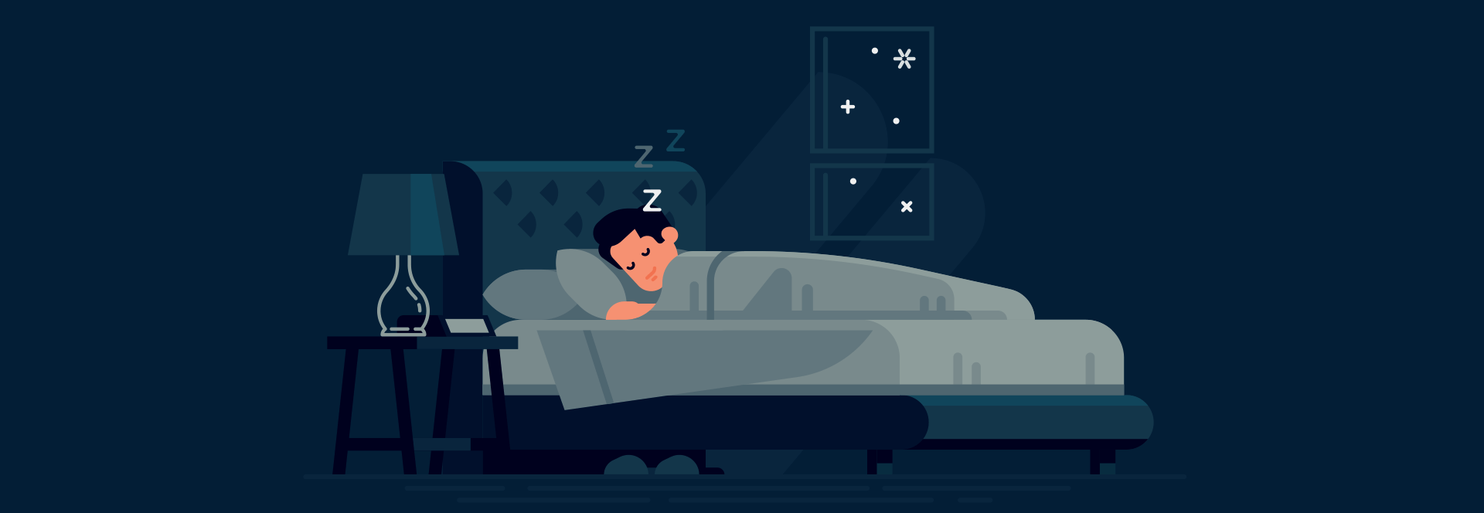
How can we look after our own mental health?
Get more from your sleep
We all have times when we sleep badly, and some of us live in situations that make a good night’s sleep impossible.
For many people, sleep is often the first thing that suffers when we struggle with our mental health.
Adults need between 7 and 9 hours of sleep a night, including enough dreaming sleep and enough deeper sleep.
If you’re struggling with sleep, think about making a few simple changes.
For example:
Develop a relaxing bedtime routine to help you start winding down before you actually go to sleep
Avoid TV and mobile screens, alcohol and caffeine before bed. This will help you fall asleep and stay asleep. You could also avoid vigorous exercise before bed.
Go to bed and get up at around the same time every day, including weekends.

Slide 10
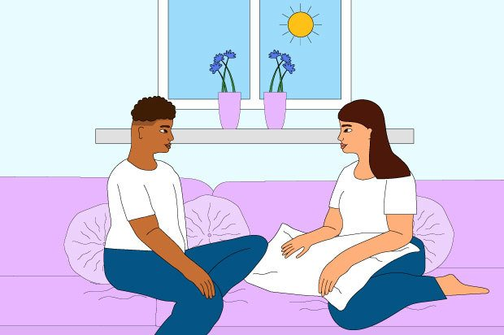
How can we look after our own mental health?
Talk to someone you trust for support
Many of us have learned to bottle things up inside us and try to ignore painful feelings. It can take a lot of courage to tell someone else how we’re feeling or what we’re finding hard, especially if we don’t usually do that kind of thing.
Just talking things through with a person we trust can help and feel like a relief.
Talking may change the way you feel about a situation
Use your own words. It’ll make you feel safer and less alone, and that will help protect your mental health and prevent problems.
Talking may also change how you see and feel about the situation in ways you find helpful.

Slide 11
How can we look after our own mental health? https://www.youtube.com/watch?v=x6bz_ekkrYA

Slide 12
Where can you find support?
Family
Friends
Teachers
Other trusted adults

